Slide 1
How to Avoid MTurk’s Extra 20% Price Gouge: A Click-by-Click Guide for Academic Requesters
Compiled by Charles Foster of Stanford's Laboratory for Social Research (lsr.stanford.edu)

Slide 2
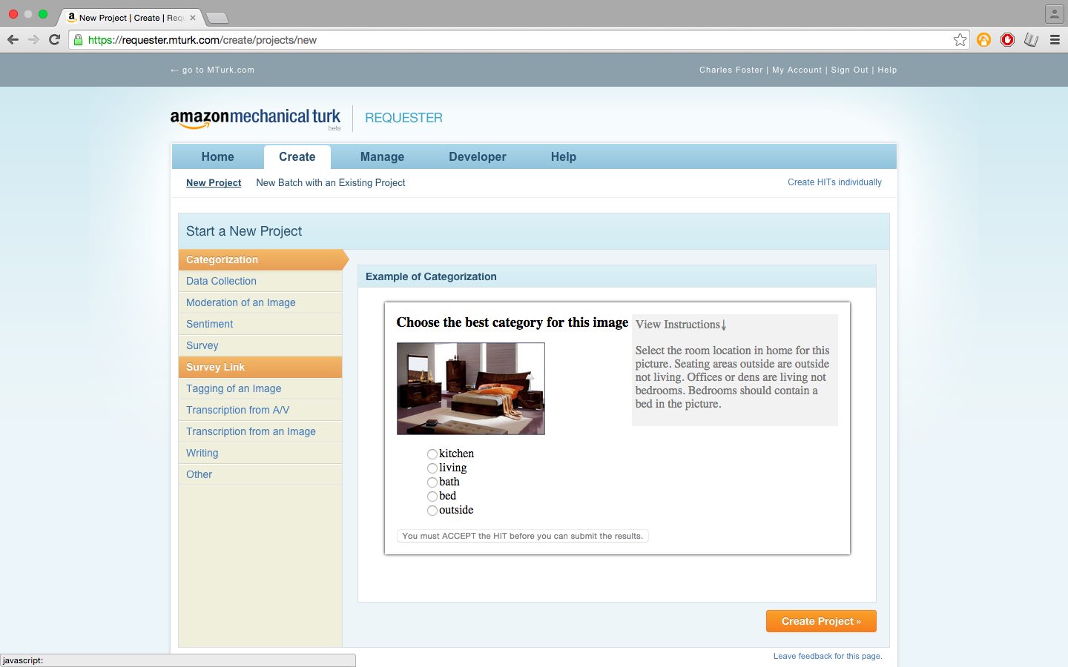

Slide 3
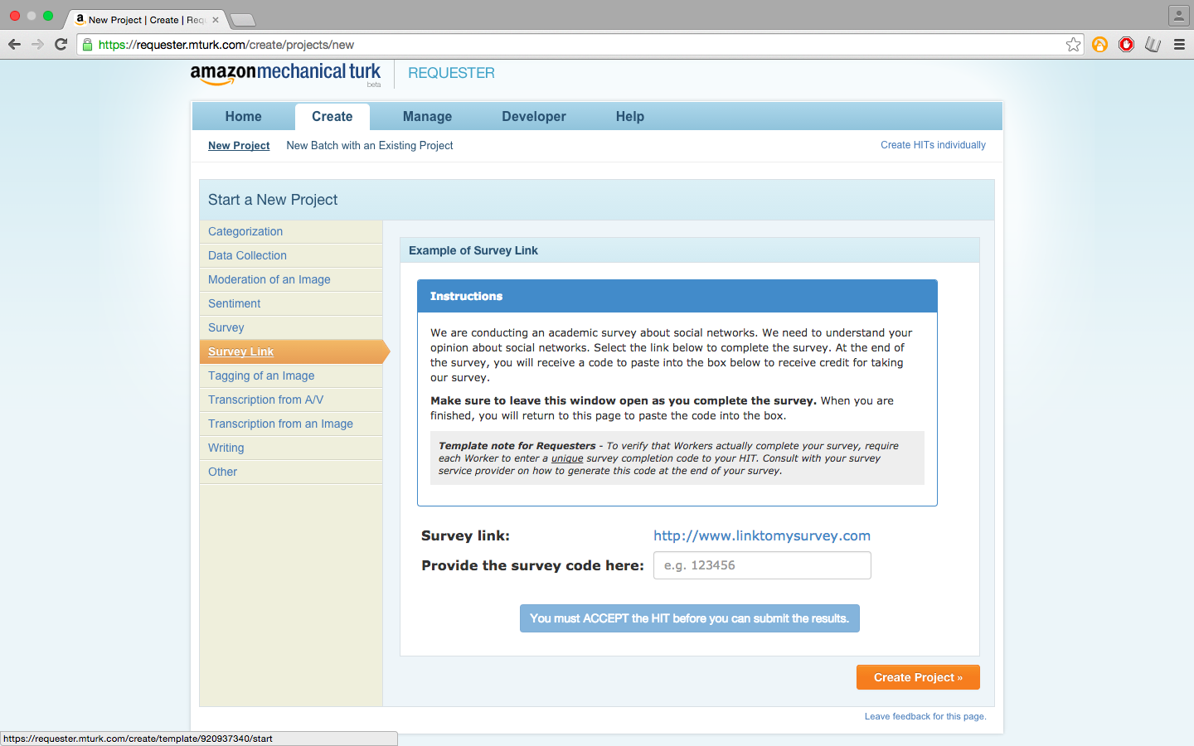

Slide 4
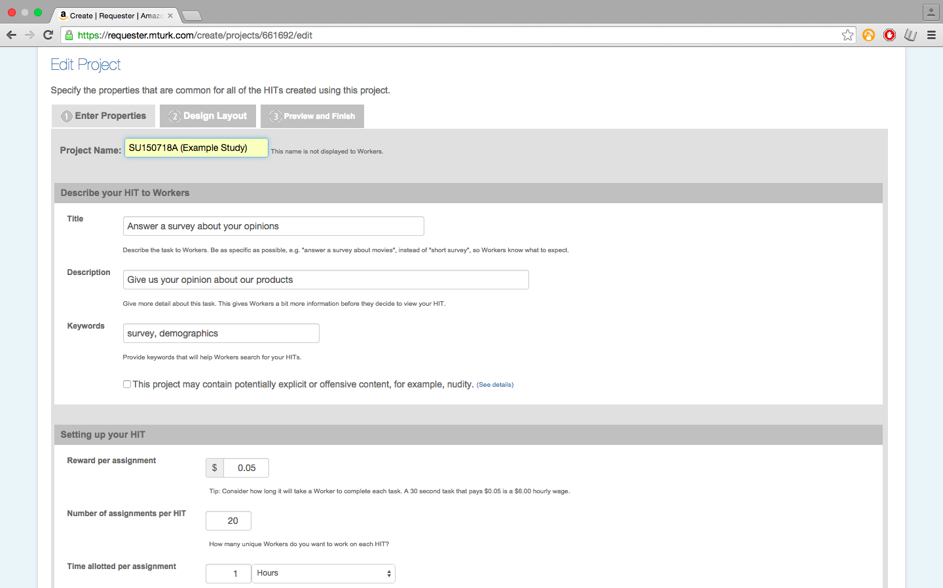
Fill in the usual study specifics here

Slide 5
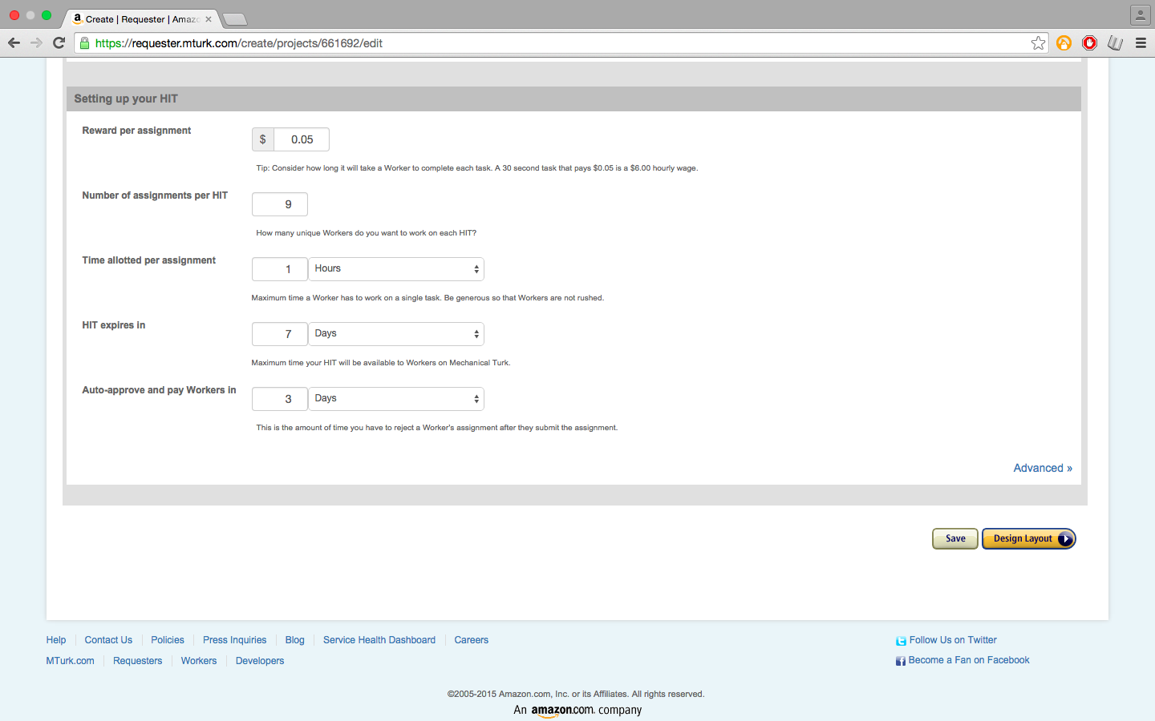
THIS STEP IS ABSOLUTELY, POSITIVELY CRUCIAL:
Set the number of assignments to 9 (or less)

Slide 6
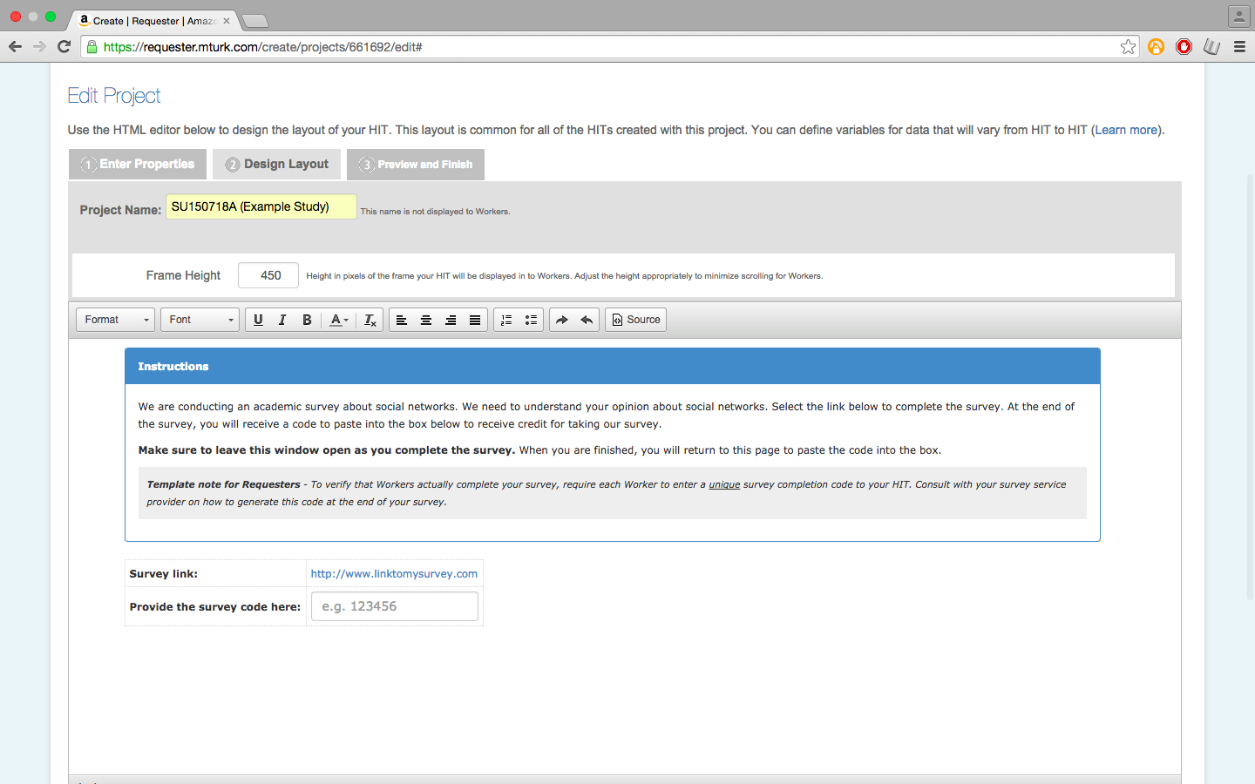

Slide 7
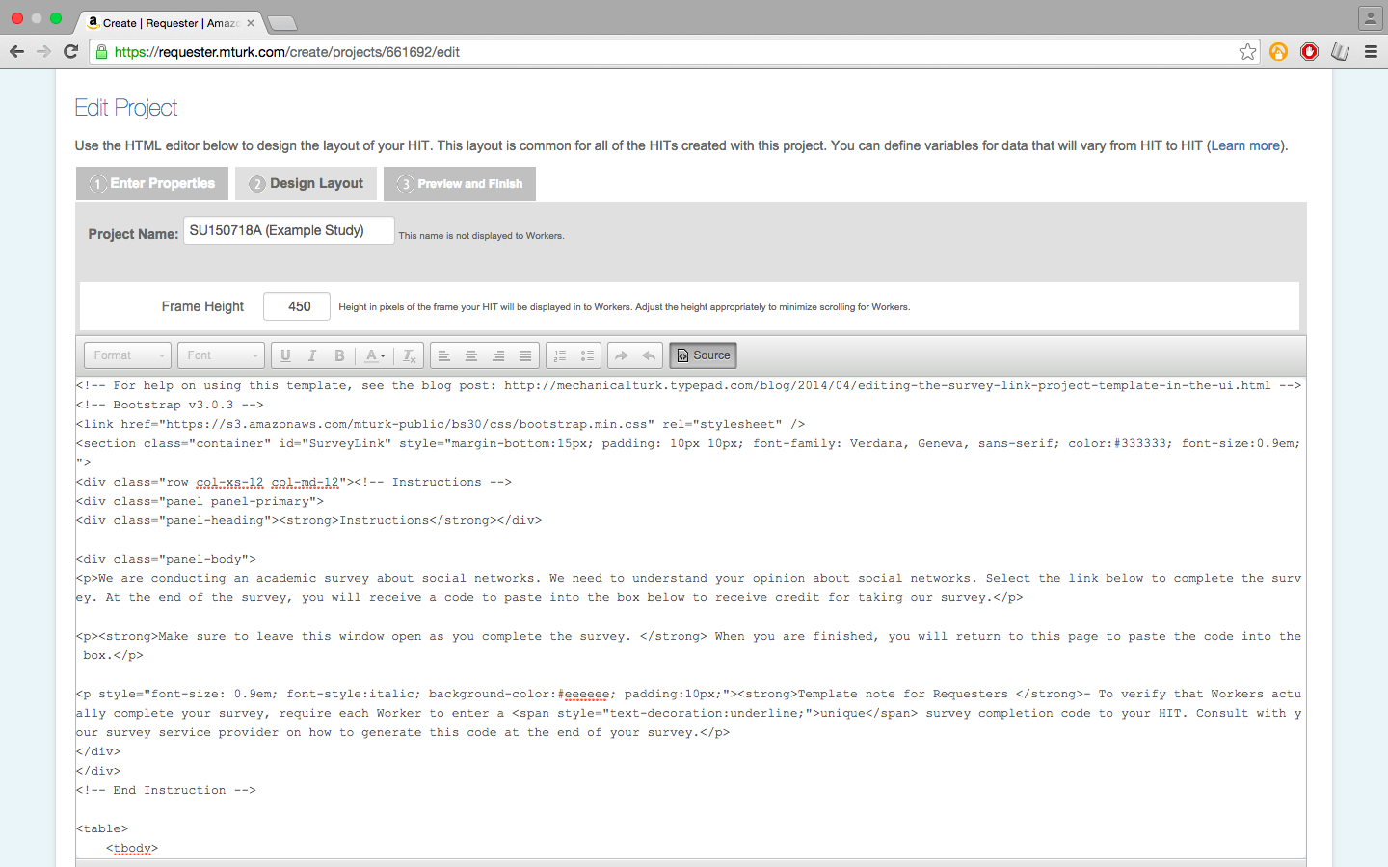

Slide 8
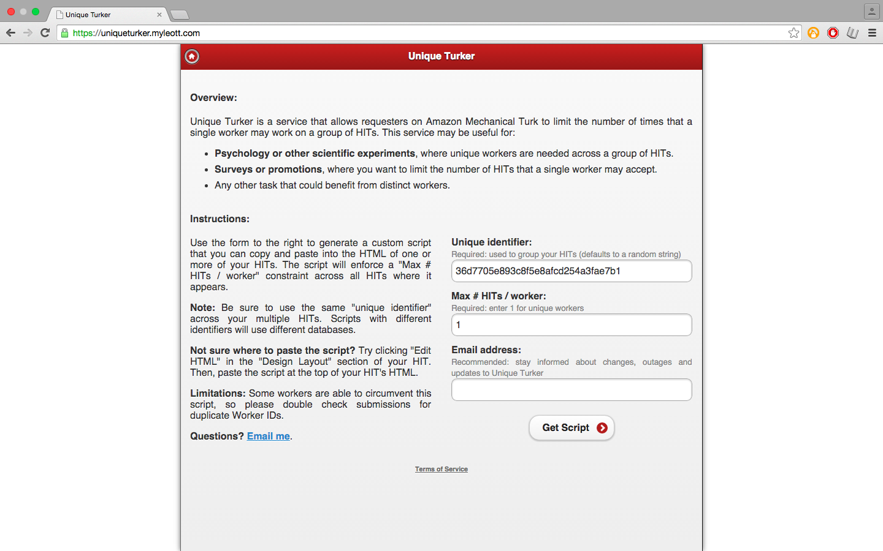
Navigate to this website

Slide 9
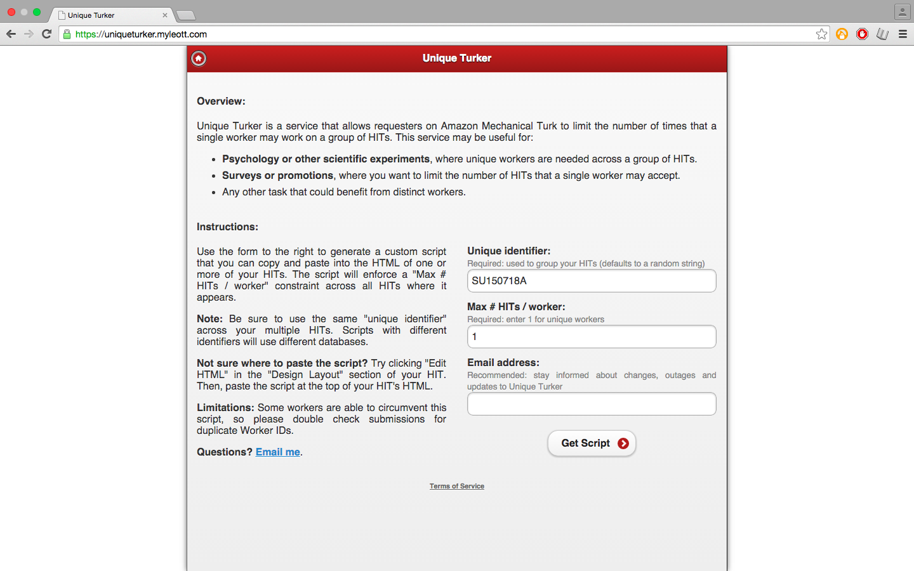
For each distinct survey, make sure you use a different unique identifier, or else workers will be barred from other surveys of yours!

Slide 10
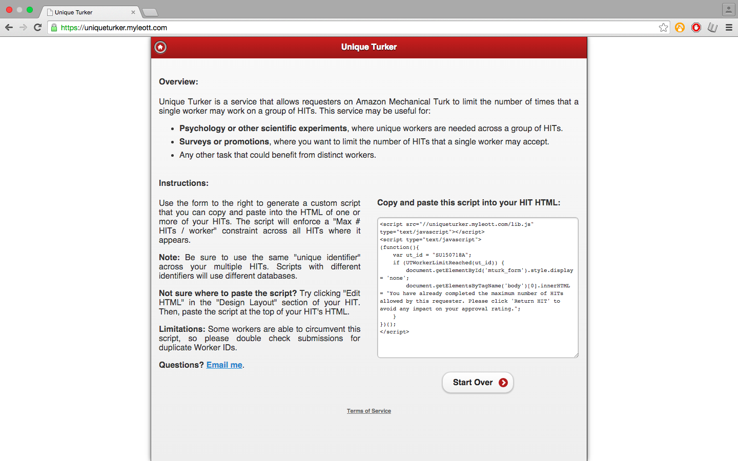

Slide 11
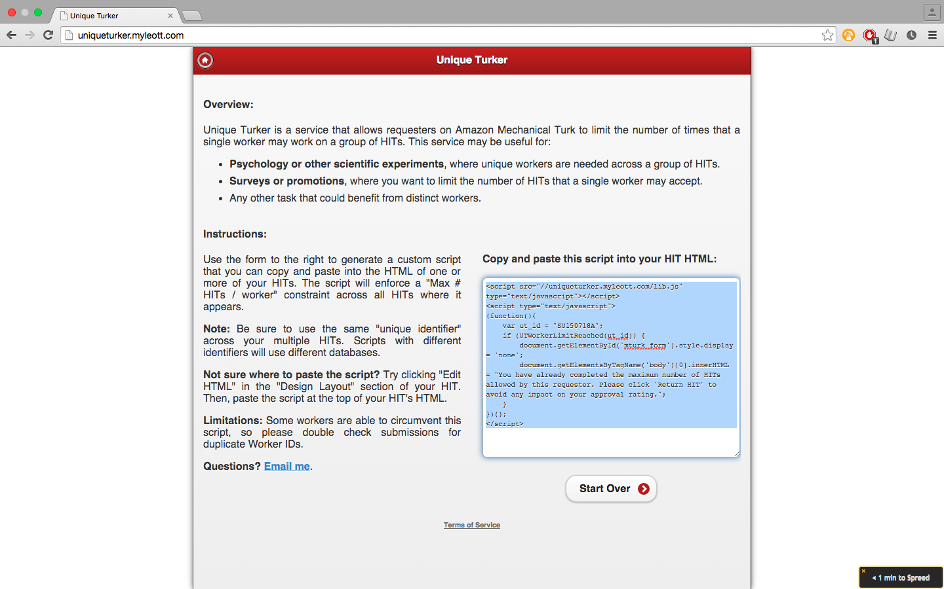
Copy

Slide 12
Paste at the top

Slide 13
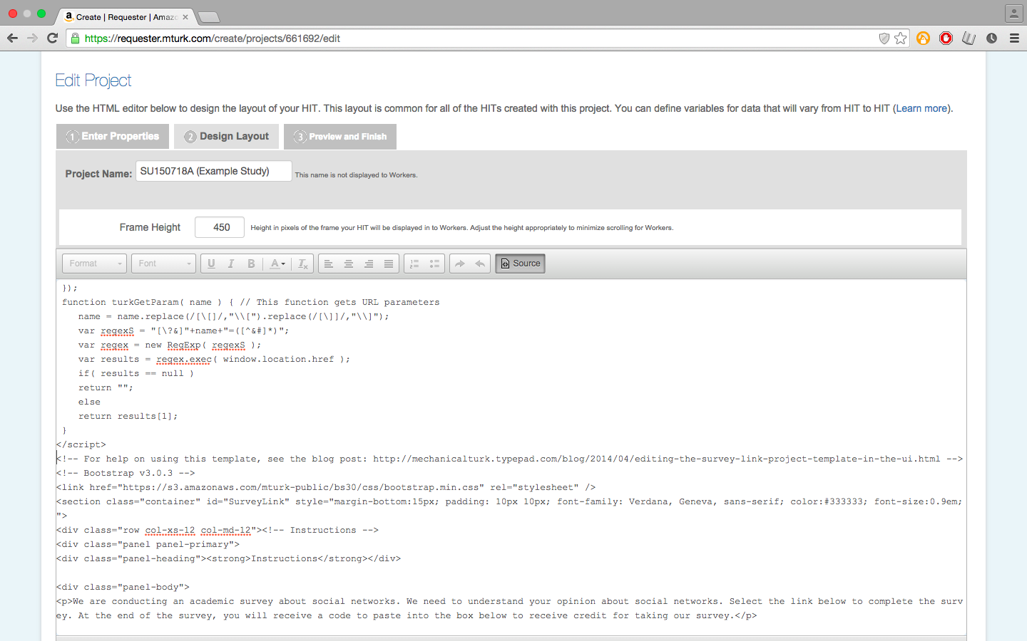
Then go to the bottom of the source code

Slide 14
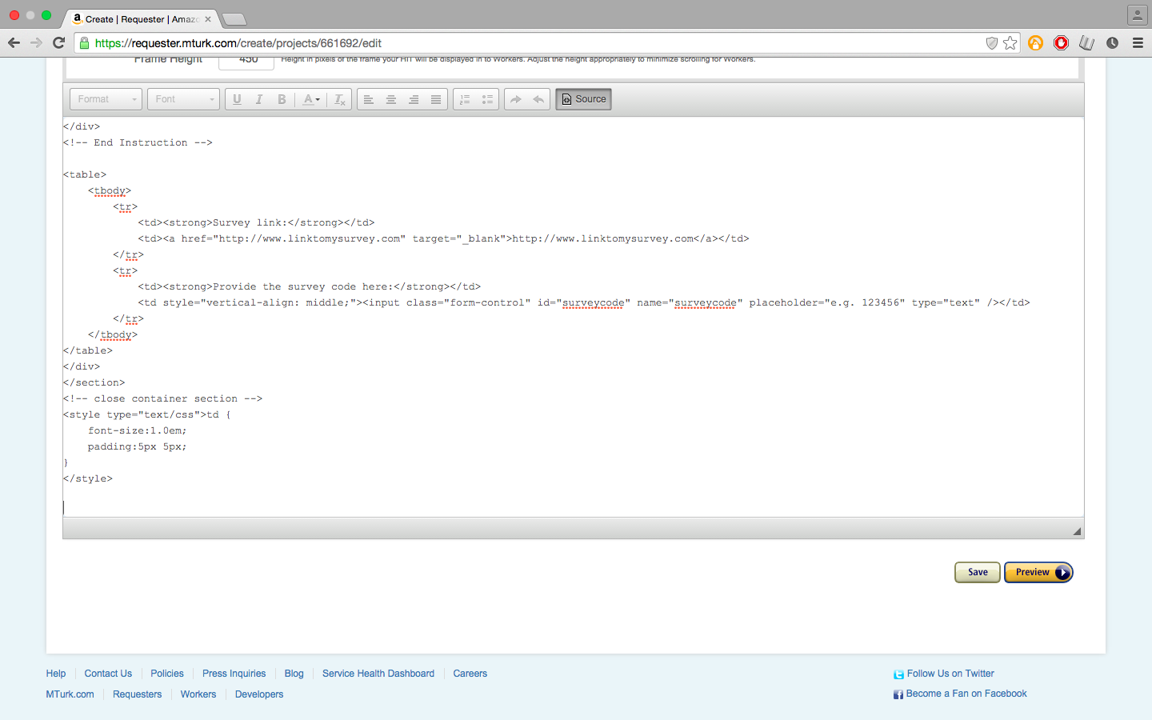

Slide 15
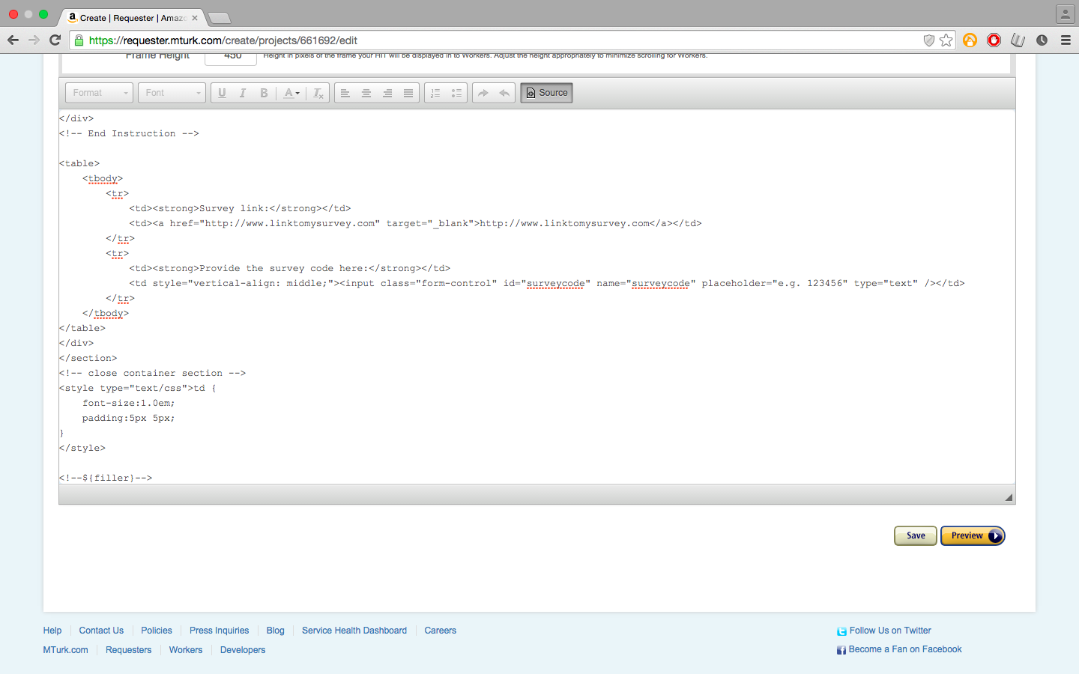
Then, click on source again.
All we’re doing here is adding a comment at the end of the code so that we’ll be able to create multiple HITs at once. It won’t have any effect on the layout. I chose to call it “filler”, but you can replace that label if you’d like.
<!--${filler}-->

Slide 16
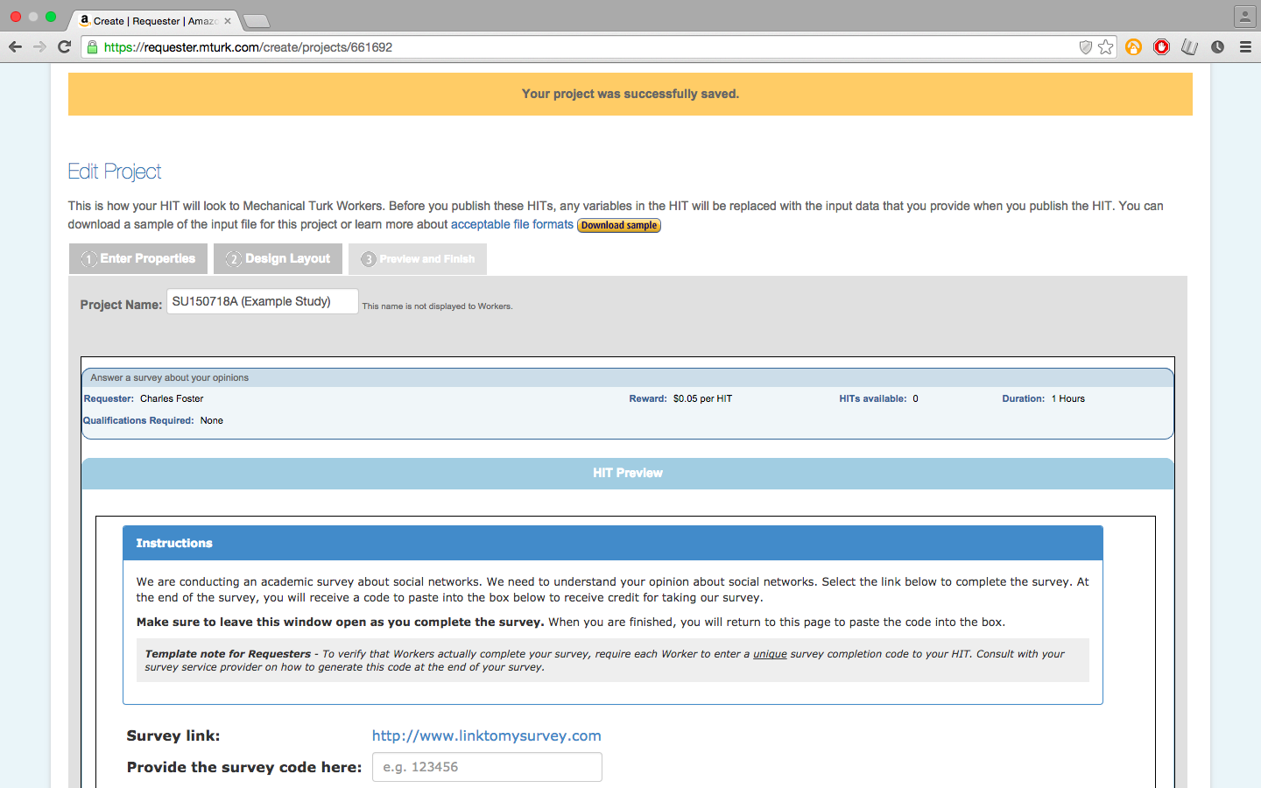
After the sample downloads, open it up in Excel or an equivalent program

Slide 17
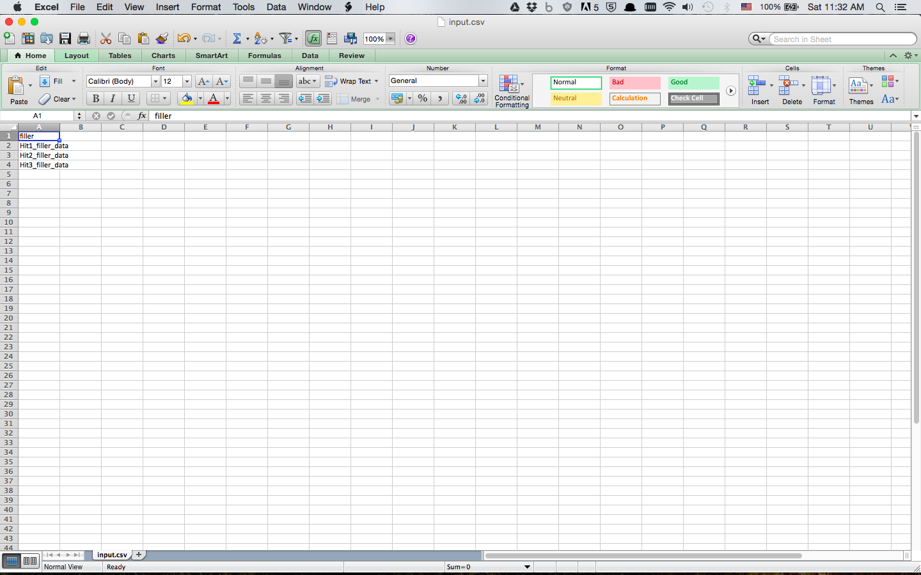

Slide 18
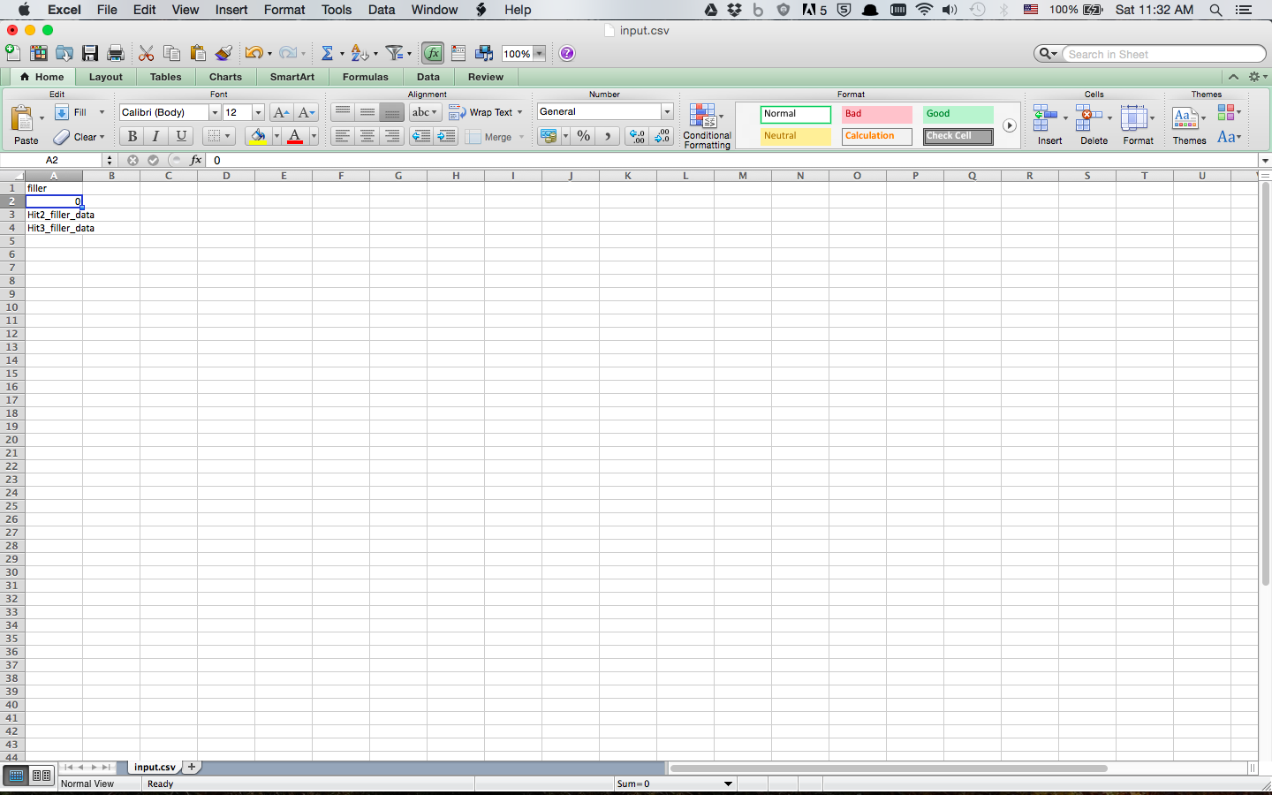
It really doesn’t matter what you put here, but for sake of convenience I use a 0.

Slide 19
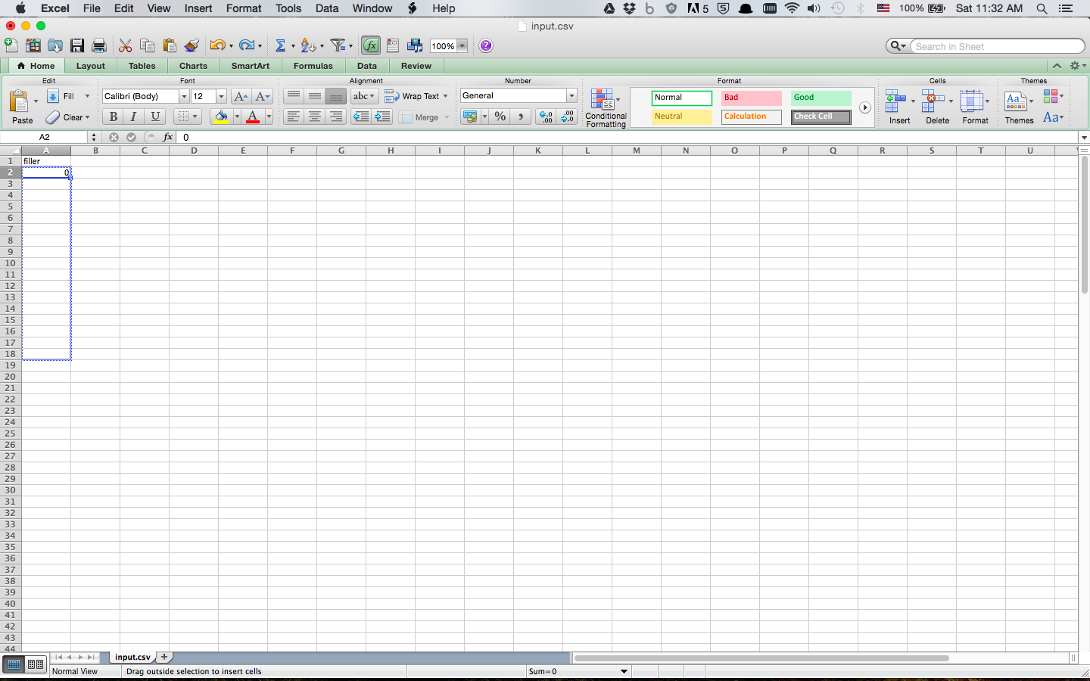
Drag from the bottom right corner of the cell downwards to populate the cells below

Slide 20
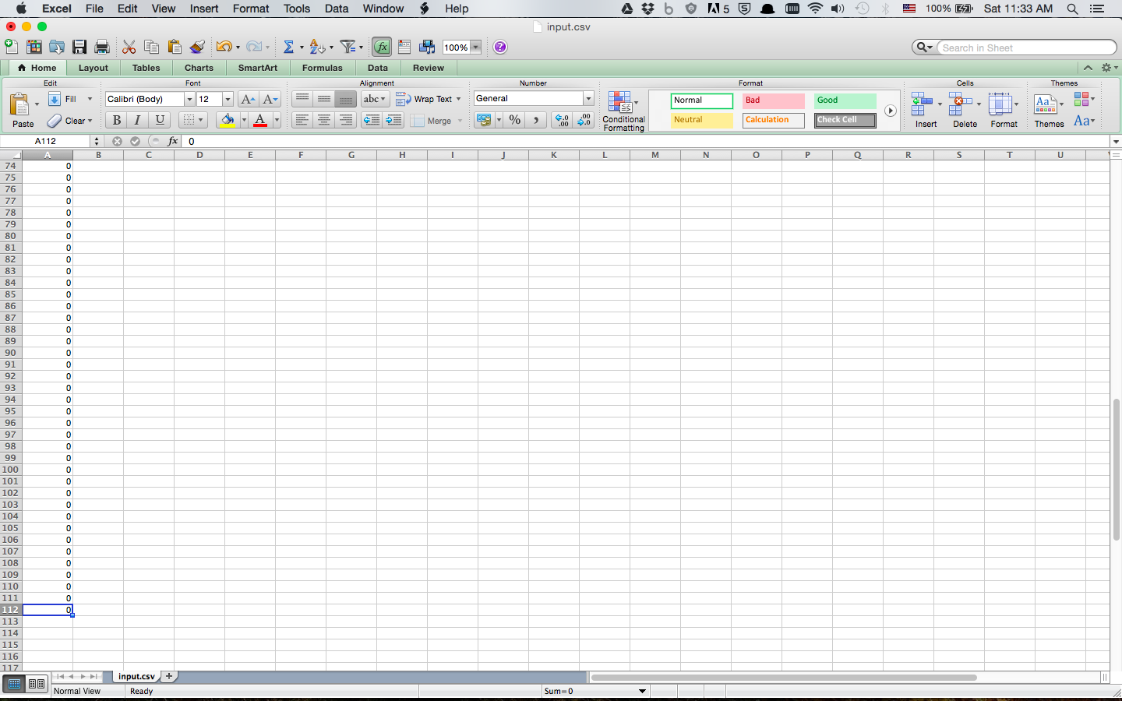
IMPORTANT STEP HERE:
Drag it all the way down to the number of participants you want to have, divided by 9 (or whatever number of participants you assigned per HIT), plus 1

Slide 21
What does that mean?

Slide 22
Say that I’d like approximately 1,000 participants in my study:
Since we’re doing HITs with 9 participants each, we’ll need 111 HITs.
And so I populate the cells from 2 down to 112.

Slide 23
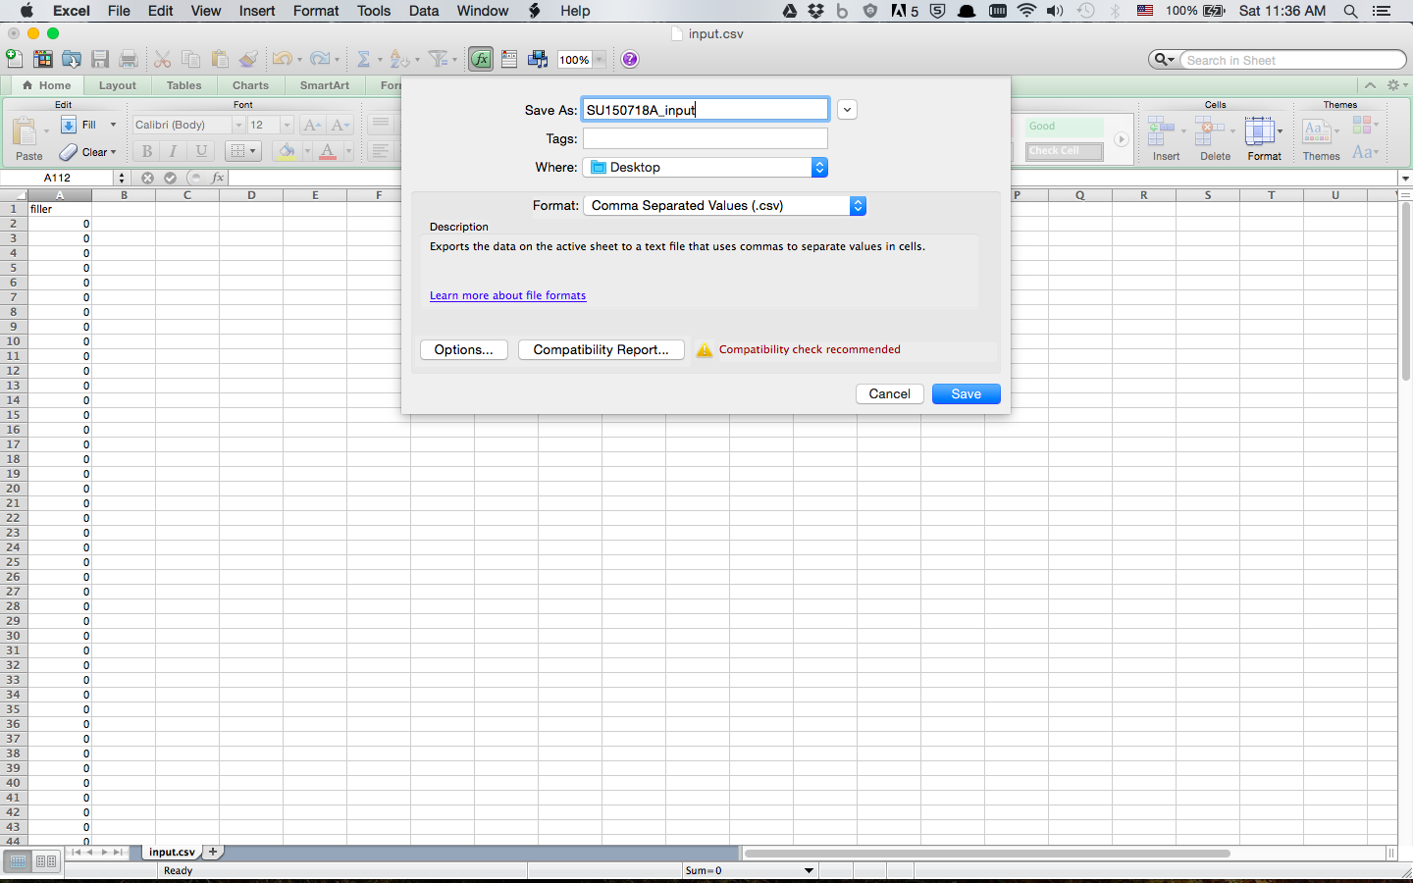
Make sure to save it as a .csv file and remember
where it’s saved
Save the file with an appropriate name and return to MTurk.

Slide 24
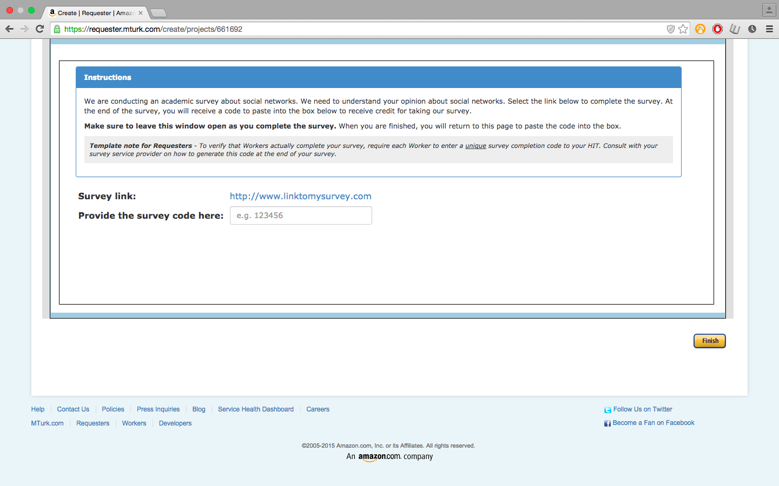

Slide 25
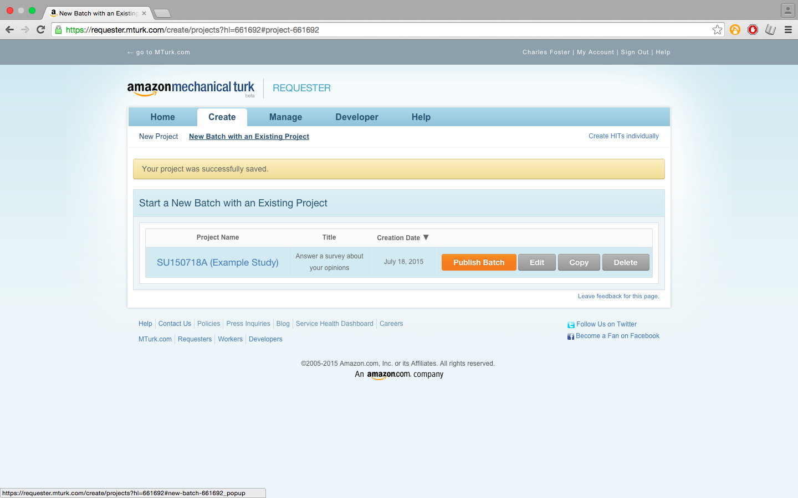

Slide 26
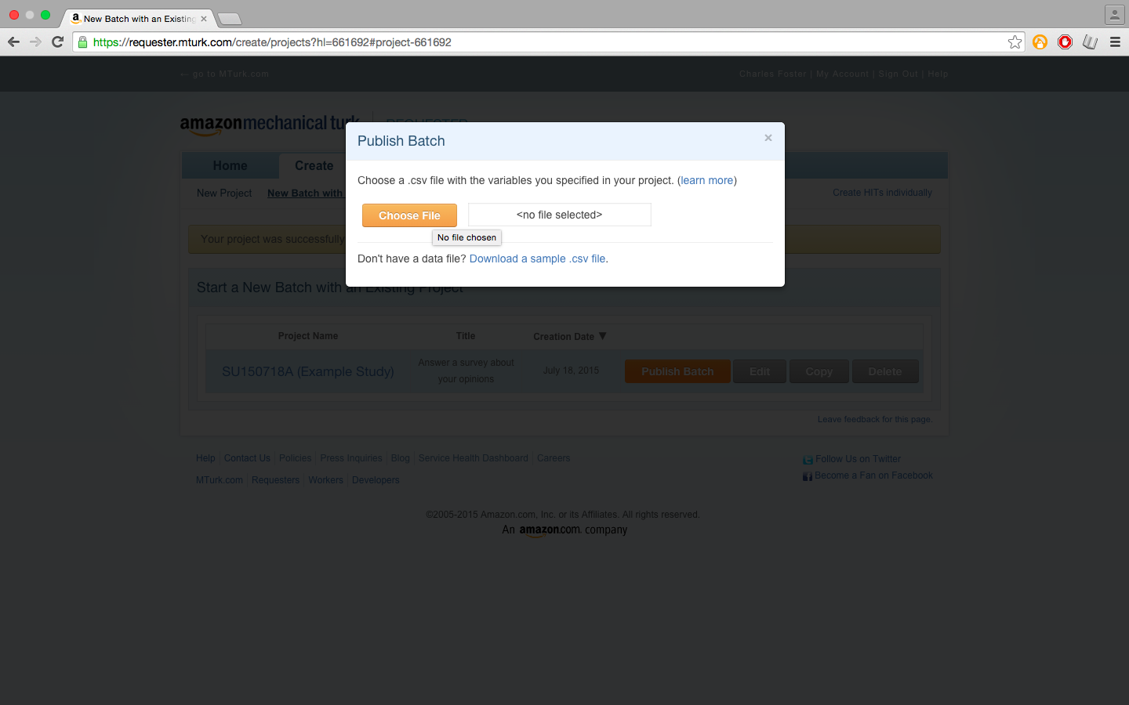

Slide 27
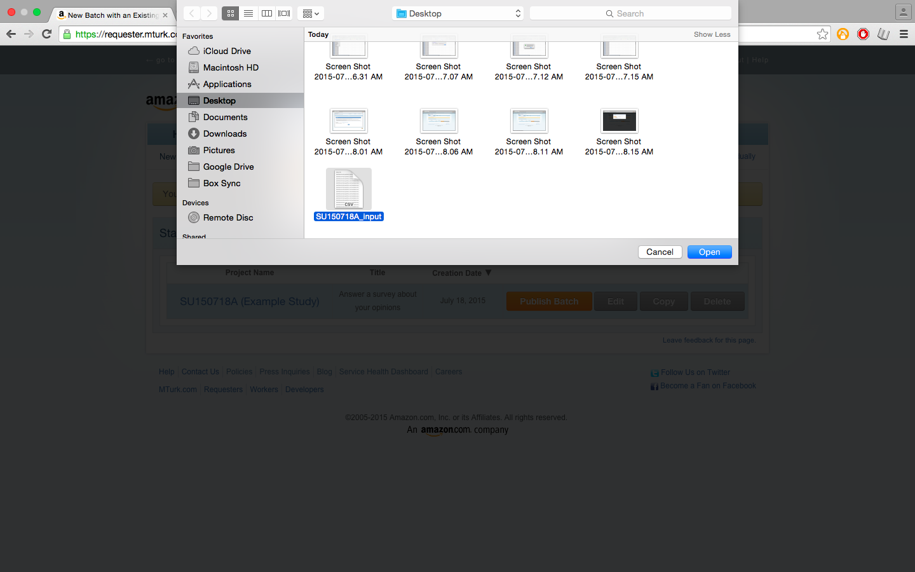
Wherever you saved the .csv file earlier, find and open it now

Slide 28
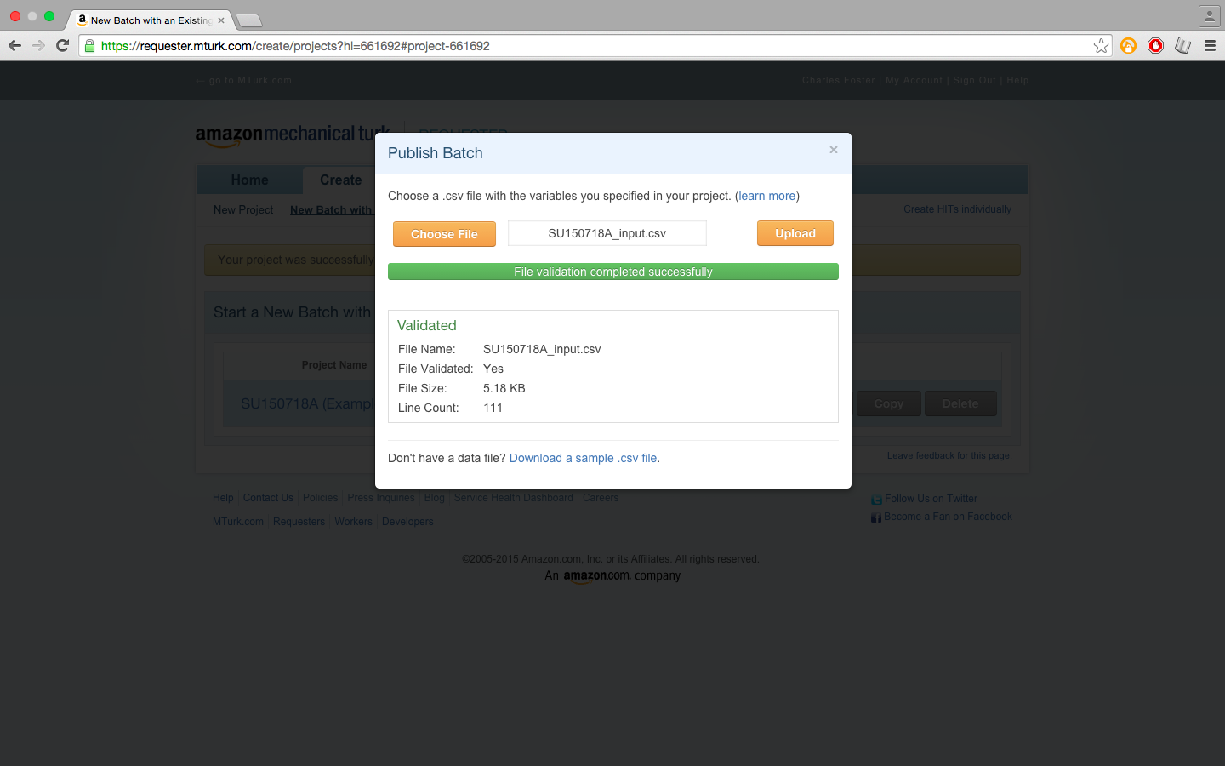

Slide 29
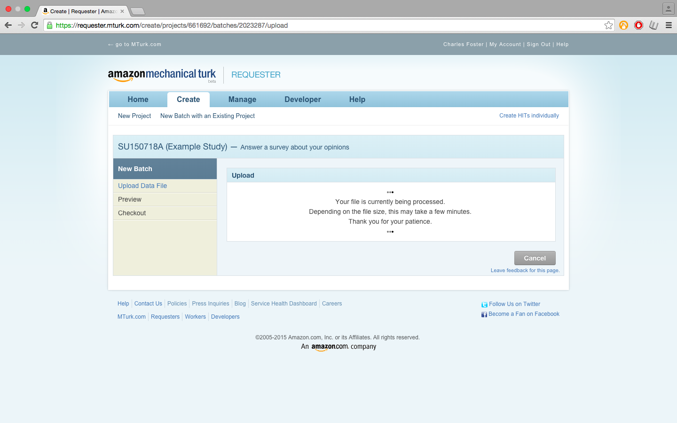

Slide 30
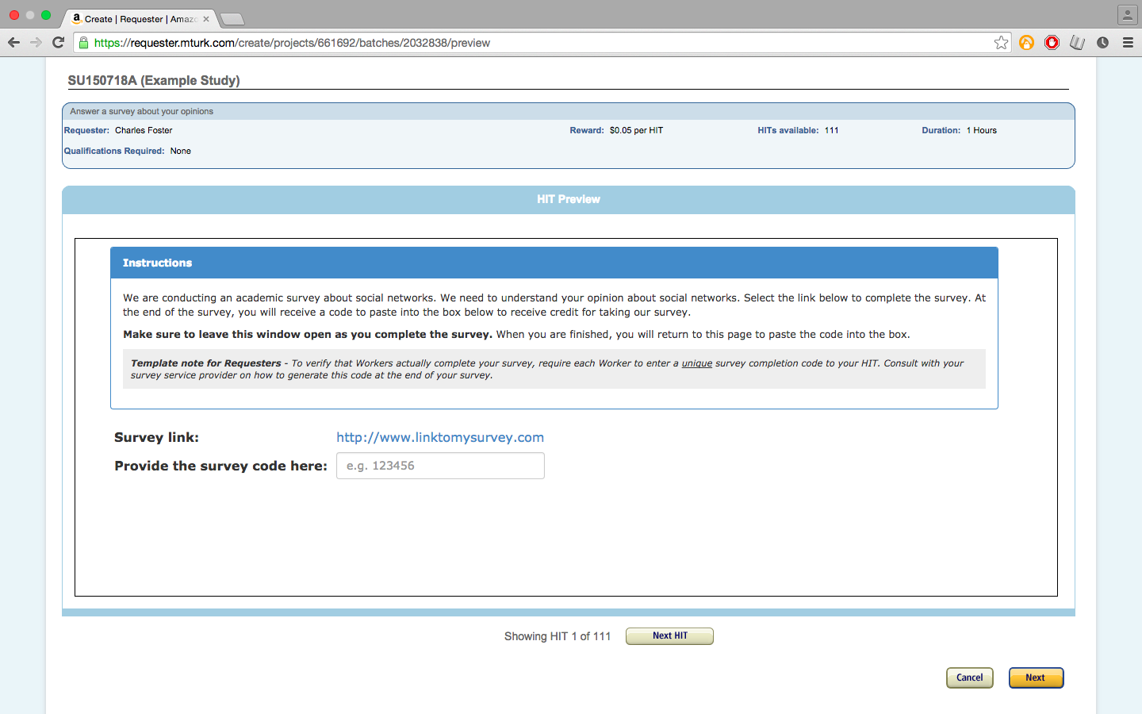

Slide 31
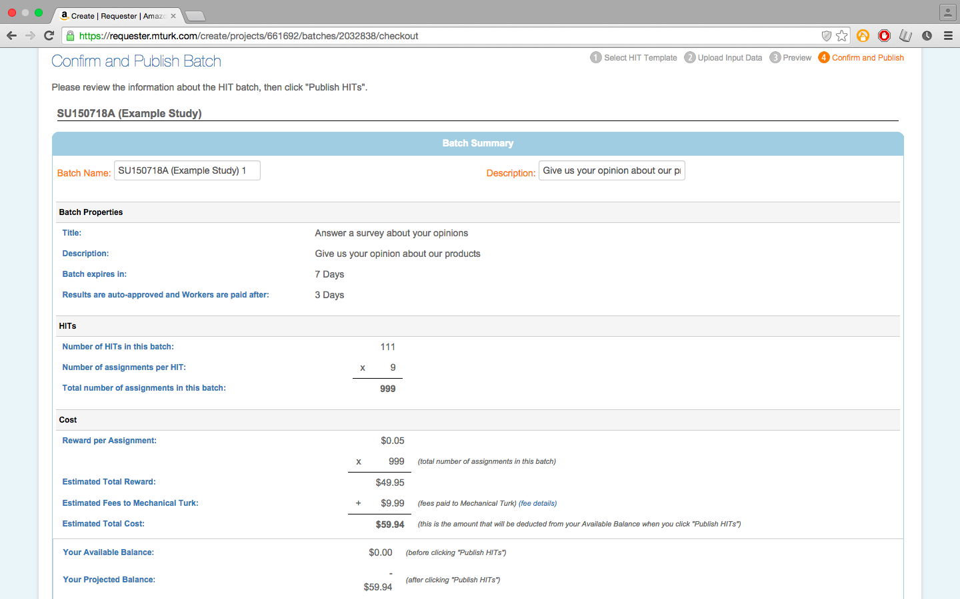

Slide 32
Done!

